Slide 1
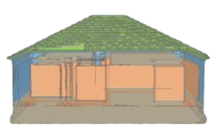
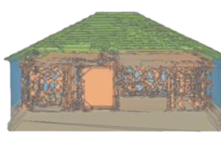
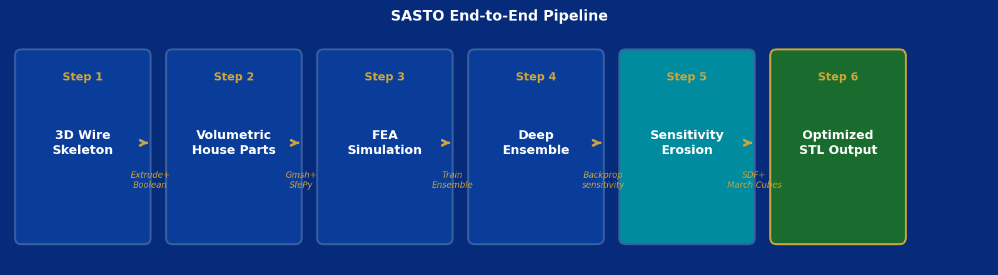
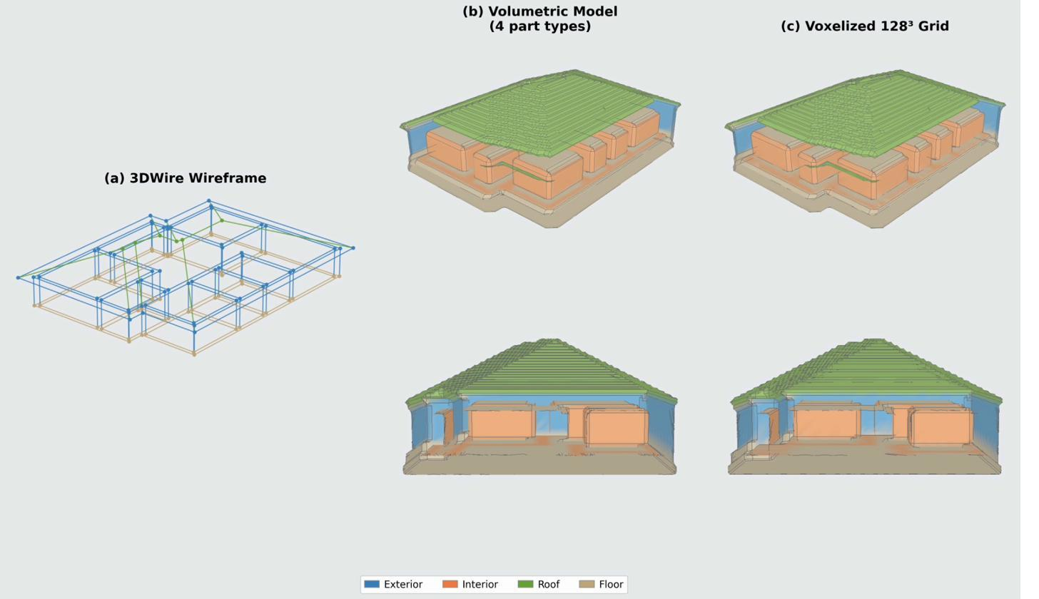
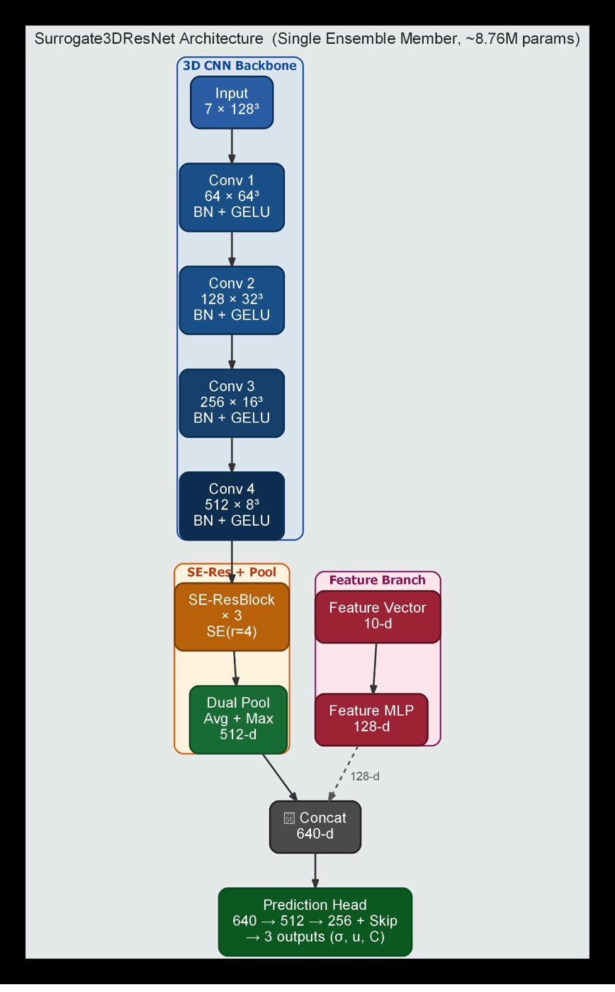
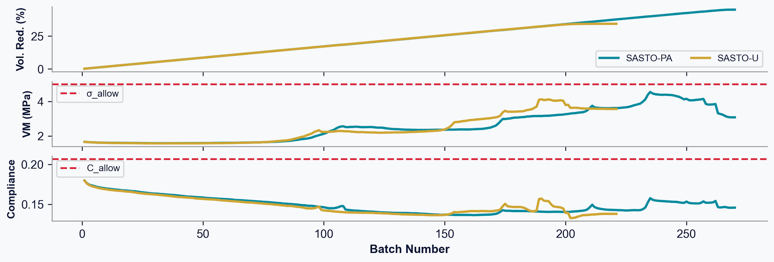
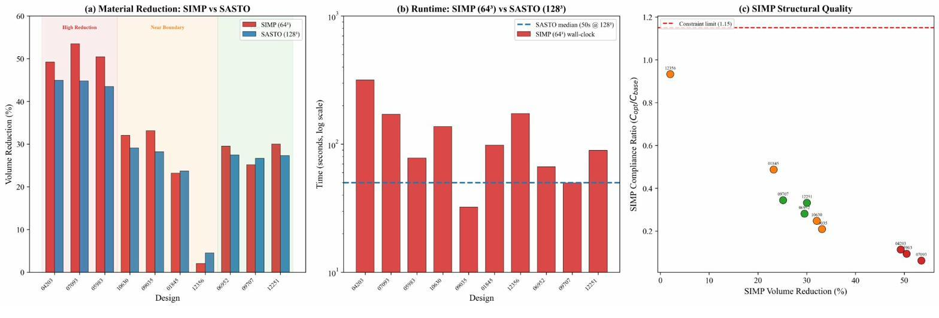
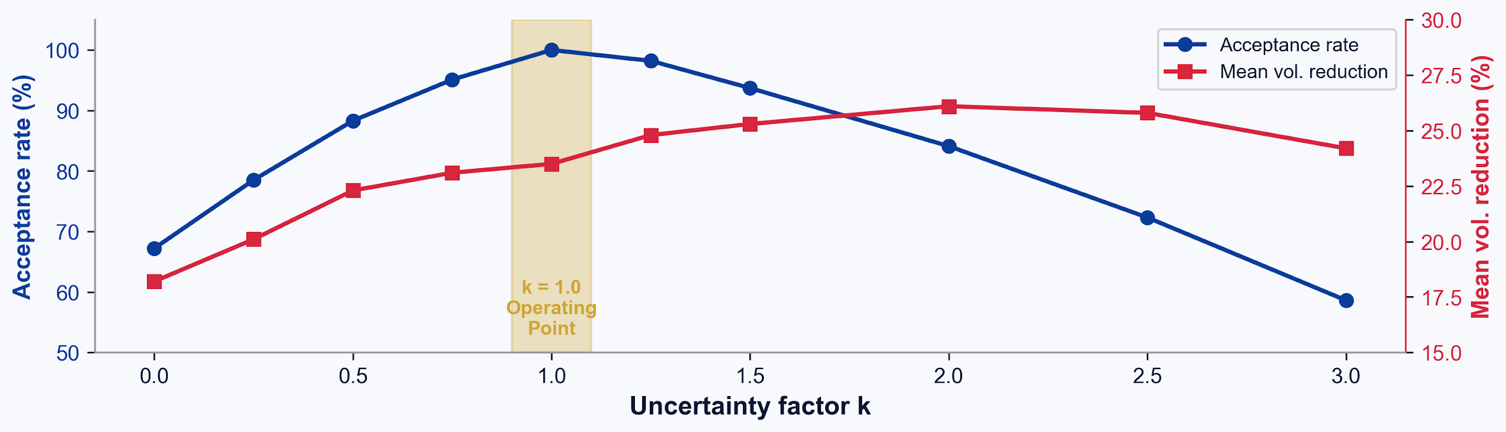
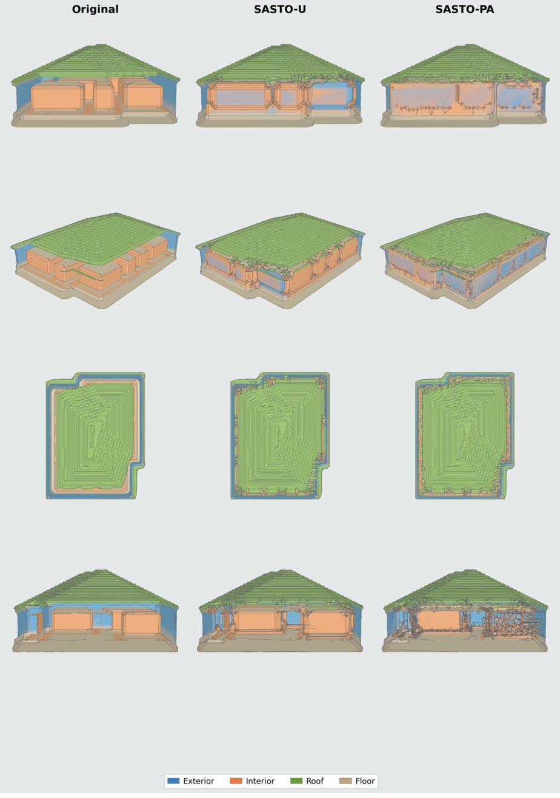
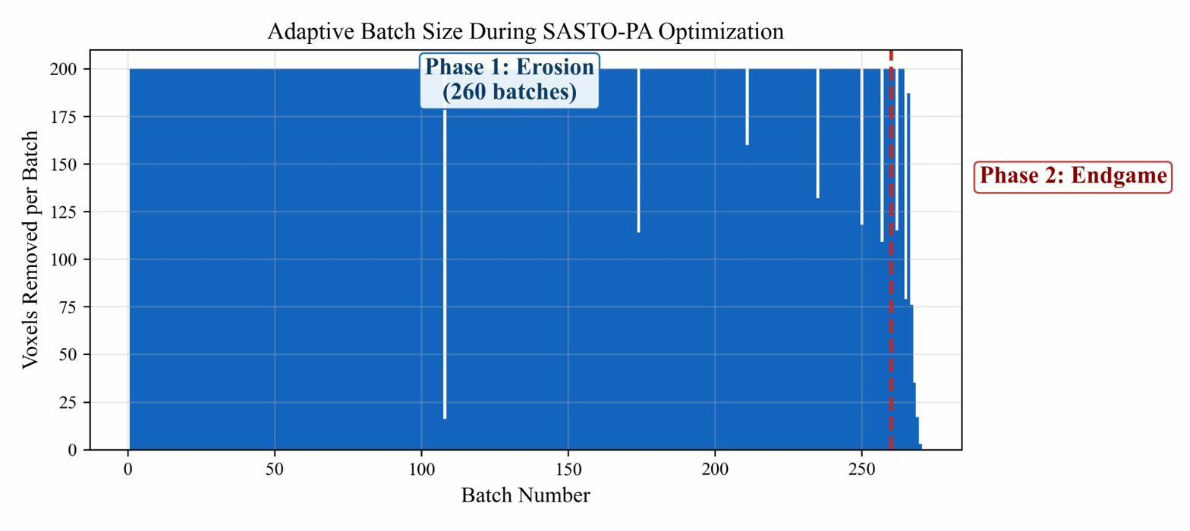
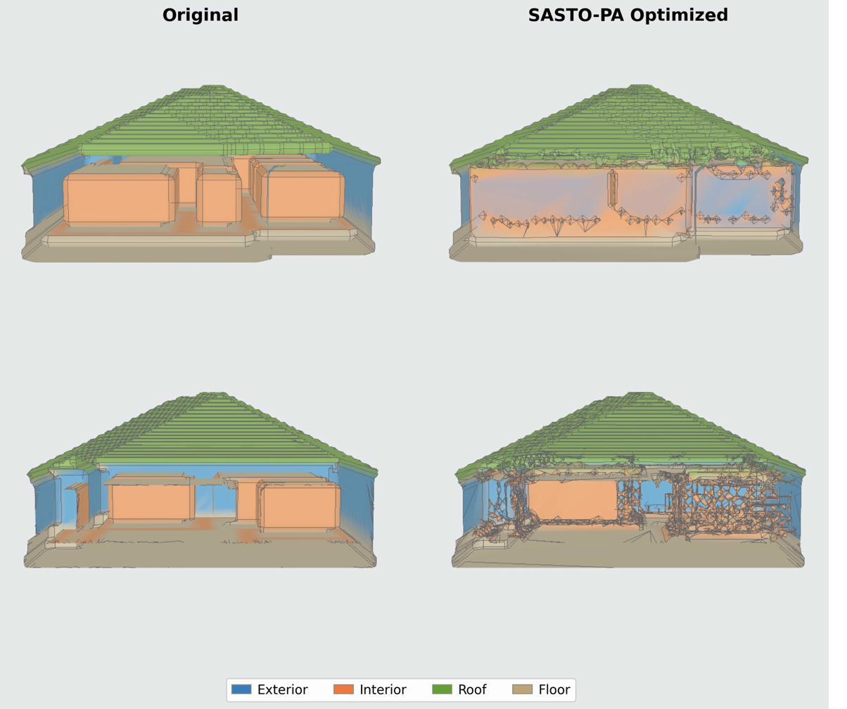
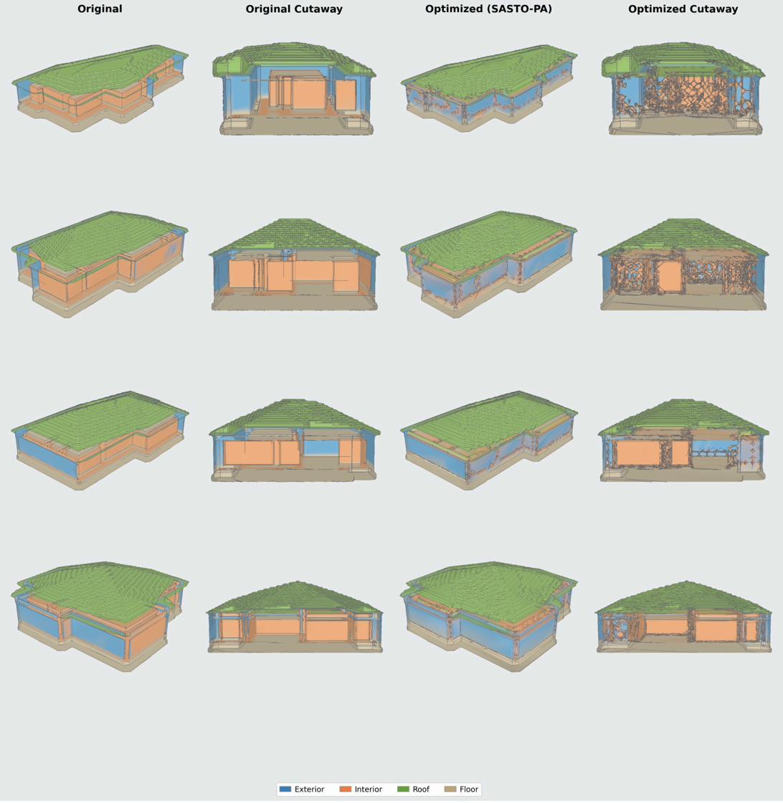
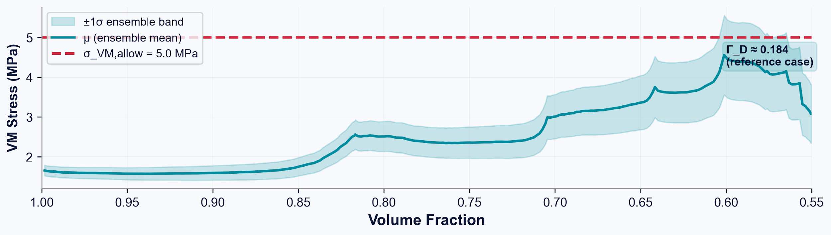
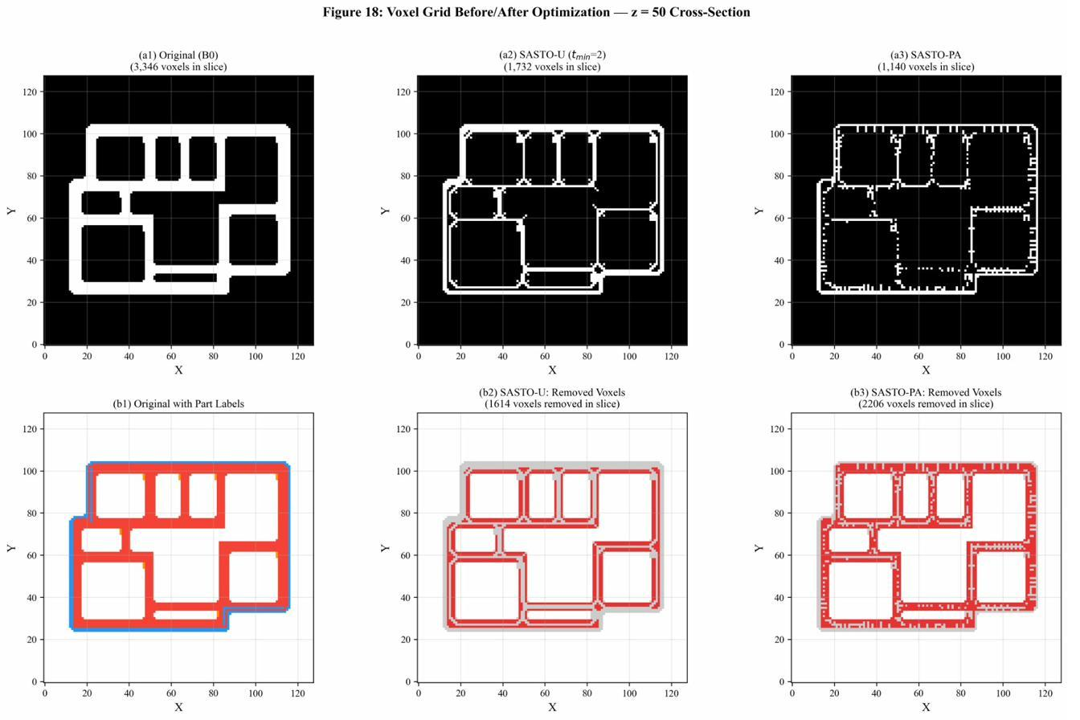
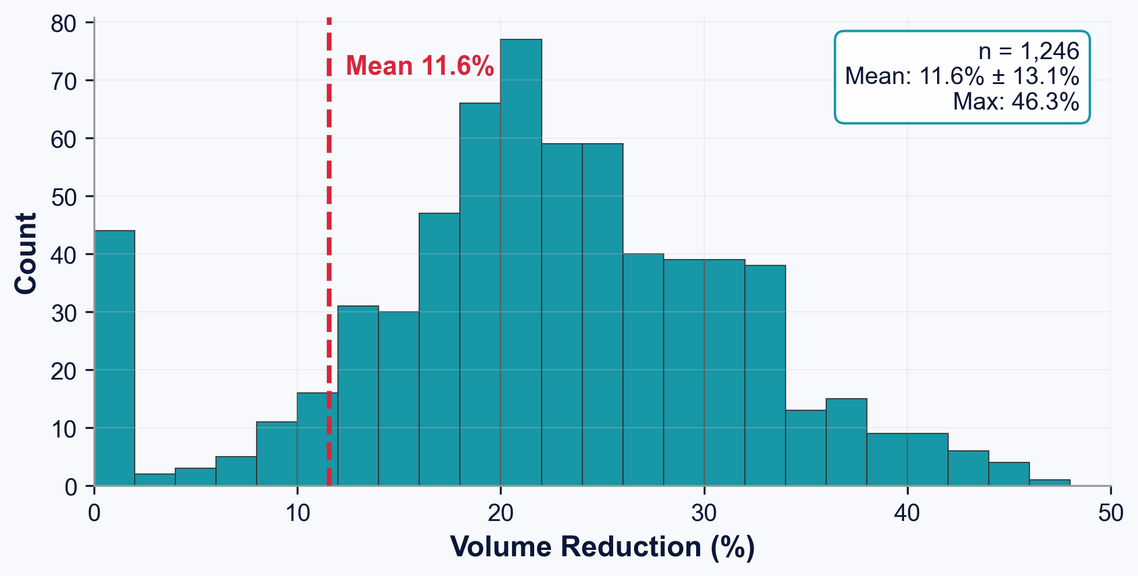
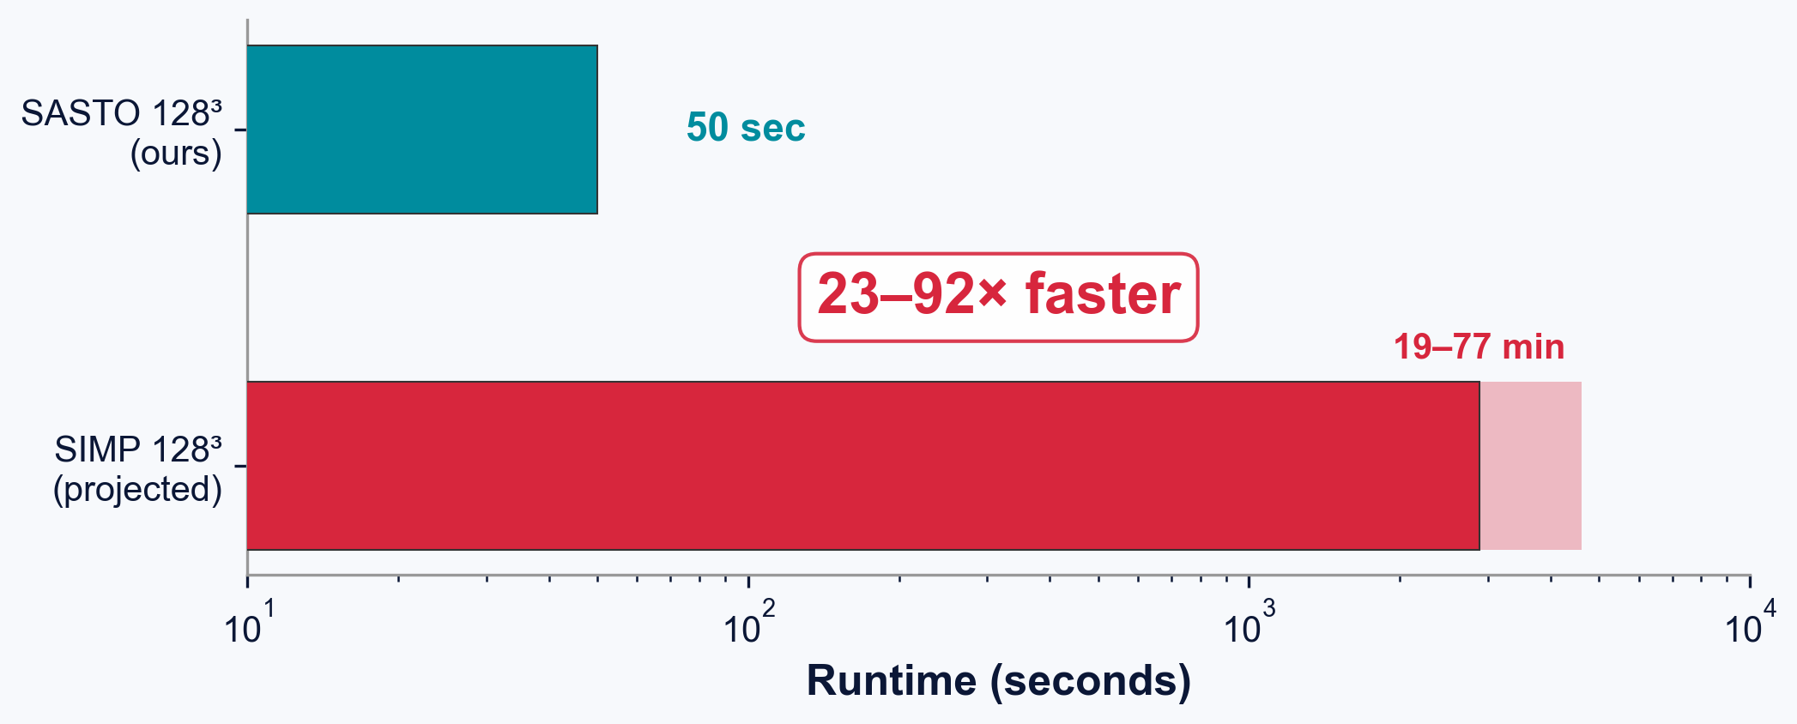
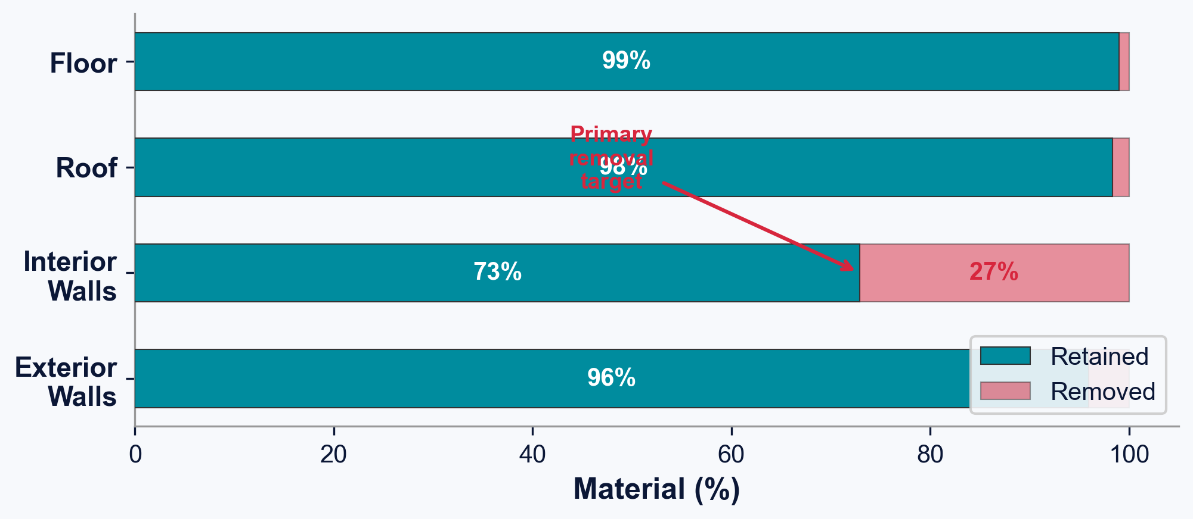
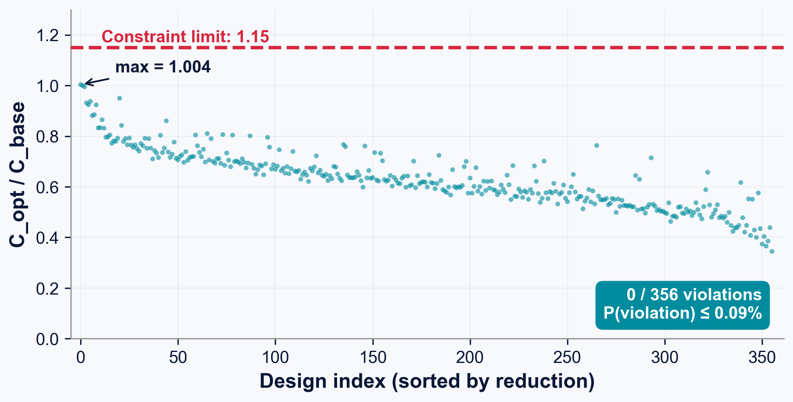
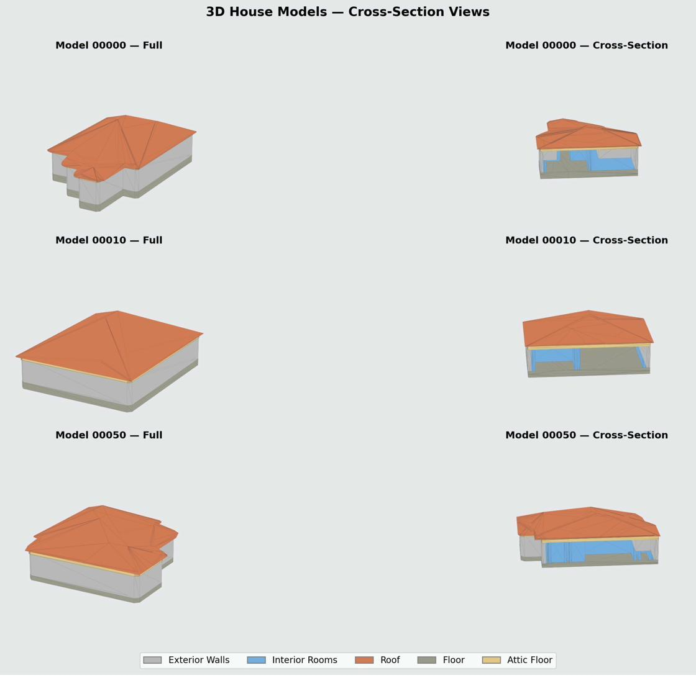
SURROGATE-ACCELERATED STRUCTURAL OPTIMIZATION
Credit Line of Origin
References & data in references below:
Images denoted with an asterisk are
public-domain or adapted sources.
All other graphics, tables, and images
have been created by Eric Hou, 2026
unless otherwise attributed.
Additive Manufacturing: Harnessing FEA to Optimize Material Efficiency
SASTO Optimization
Eric Hou
VISUAL ABSTRACT
ENGINEERING METHODOLOGY
STATISTICAL ANALYSIS
Dataset Generation Pipeline
×5 Ensemble
Surrogate Model Performance
Deep Ensemble Surrogate (5×8.76M params)
Target | Spearman ρ | R²_log | MAPE%
Von Mises stress | 0.737 | 0.419 | 37.4
Displacement | 0.970 ★ | 0.842 | 10.9
Compliance | 0.948 ★ | 0.814 | 18.5
Architecture:
• 3D CNN → Avg+Max dual-pool → 512-d embedding
• Load features concatenated after pool
• 3 regression heads: σ_VM, u_max, C
Training:
• Huber loss (SmoothL1)
• AdamW, lr = 5×10⁻⁴
• 90° rotations + flips + noise σ=0.02
• Input: log(1+|y|) → z-score
Ranking accuracy (Spearman ρ), not pointwise, drives optimization safety. Compliance ρ = 0.948.
Optimization Convergence
Fig. 1. SASTO: 3D wireframe → volumetric parts → FEA dataset → surrogate → optimization → watertight STL
Split | n | Targets
Train | 8,943 | σ_VM, u_max, C
Validation | 1,121 | —
Test | 1,114 | —
INTRODUCTION
Fig. 6. 14,293 wireframes → 11,178 FEA sims → 128³ voxel grids
Fig. 14. SASTO-PA (teal) vs. SASTO-U (gold). Part-aware thinning enables deeper removal.
▶ Concrete & Construction
Concrete = ~8% of global CO₂ [IEA 2021]. Uniform-thickness walls are determined by formwork, not structural need — wasting material.
▶ Additive Manufacturing
Large-scale 3D printing (ICON, COBOD, Apis Cor) enables topology-optimized structures with arbitrary wall profiles at no extra tooling cost.
▶ Computational Bottleneck
Classical SIMP: hundreds–thousands FEA solves, each minutes–hours at building scale. Produces disconnected mesh fragments.
Hyperparameter | Value
Loss | Huber (SmoothL1)
Optimizer | AdamW, lr = 5e-4
Augmentation | 90° rotations, flips, noise σ = 0.02
Input | log(1+|y|) → z-score
k-Factor Sensitivity (Pareto Frontier)
SASTO Algorithm — Sensitivity-Guided Erosion
Fig. 7. Dual pooling → 512-d embed fused with load features → 3 outputs
k=1.0 Operating Point
Topology: 6-Connectivity Guarantee
26-CONN — FAILS
6-CONN — WORKS
Fig. 15. Non-monotonic: both gate and budget depend on k. k=1.0 is Pareto-optimal.
vs.
Conformal Prediction Calibration
SASTO replaces FEA with a deep ensemble surrogate achieving 23–92× speedup and zero constraint violations across 1,114 designs.
✗ Thousands of floating fragments — Unprintable
✓ 1 connected component Watertight STL confirmed
RESEARCH OBJECTIVES
Proposition: A binary voxel field with exactly one 6-connected foreground component yields a single-component marching-cubes surface mesh.
Fig. 16. Uncertainty bands widen. Γ_D ≈ 0.184 (ref). P(violation) ≤ 0.09%.
FACE-share (6-adj) = printable ✓
CORNER-share only = fragment ✗
1
SPEED
23–92× speedup via deep ensemble surrogate
Fig. 9. 6-connectivity eliminates floating fragments incompatible with AM toolpath generation.
2
PRINTABILITY
6-connected single-mesh watertight guarantee
3
EFFICIENCY
23.5% mean material reduction (up to 45%)
4
SAFETY
0/1,114 FEA violations; P(violation) ≤ 0.09%
CONCLUSIONS
1. Data Generation
►
2. Surrogate Training
►
3. SASTO Optimize
►
4. Validate & Certify
Phase 1: Sensitivity-Guided Erosion (>99% of removal)
Phase 2: Endgame (B=5, then 1)
1
SASTO achieves 23.5%±7.8% mean material reduction across 1,114 held-out geometries, up to 45.0% on individual designs.
Phase 3: Swap Moves (interior ↔ removed neighbor)
Trust-region: constraint violated → undo, halve B → max(B/2, 10)
ENGINEERING DESIGN CRITERIA
Fig. 8. Phase 1 provides >99% of removal. Phases 2–3 squeeze remaining feasible voxels.
2
Deep ensemble surrogate provides 23–92× speedup vs. SIMP: median 50 s on consumer GPU vs. 19–77 min for SIMP.
RESULTS & IN-SILICO VALIDATION
3
6-connectivity eliminates thousands of floating mesh fragments (26-conn), guaranteeing watertight single-component STLs.
Constraint | Limit | Basis
Von Mises stress | σ_VM ≤ 5.0 MPa | f'c/(γ_m×γ_f)
Compliance ratio | C_opt/C_base ≤ 1.15 | 15% stiffness limit
Displacement | u_max ≤ L/360 ≈ 28 mm | ASCE 7-22
Wall t (exterior) | 2Δx ≈ 156 mm | Load path
Wall t (interior) | 1Δx ≈ 78 mm | Non-structural
Mesh integrity | 1 component | Printability
Reference Case (Sample 00472)
1,114-Geometry Generalization
Speedup vs. SIMP
4
Part-aware thickness yields 10.7pp more reduction than uniform by permitting 1-voxel interior walls.
σ_VM,allow = f'c / (γ_m × γ_f) = 30 MPa / (3.0 × 2.0) = 5.0 MPa Conservative: μ_σ + k·σ_σ, k = 1.0 | P(violation) ≤ 0.09%
5
Independent FEA re-analysis of all 1,114 designs: zero violations (max 1.004). Conformal: P(violation) ≤ 0.09%.
−45.0% material
Fig. 12. SIMP 64³: 94s; SASTO 128³: 50s. 23–92× faster.
🌍 8% of global CO₂ = cement. 23.5% less concrete per house → millions of tons saved at scale.
Fig. 10. Volume reduction. n=1,114 | Mean: 23.5%±7.8%
Independent FEA Re-analysis (n=1,114)
FUTURE WORK
Per-Part Material Retention
0/1,114 violations
PROBLEM FRAMING
Metric | Baseline | SASTO-PA
Vol. reduction | — | 45.0% ★
VM stress (Pa) | 3.08e6 | 3.08e6 ✓
Compliance ratio | 1.00 | 1.004 ✓
Mesh components | 1 | 1 ✓
Runtime | — | 160 s
EI Index | — | 0.358 ★
P(violation) ≤ 0.09%
1
FEA-IN-THE-LOOP ACTIVE LEARNING
Optimization Objective
When ensemble Γ_D > threshold τ, trigger ground-truth FEA mid-optimization. Self-correcting safety net.
min J(ρ) = w_V·(V/V₀) + w_S·(S/V₀) + P_constraint(ρ)
2
NONLINEAR FEA SPOT CHECKS
Sensitivity Formula
Table 1. SASTO-PA: 10.7pp more than SASTO-U
Concrete damaged plasticity (CDP) on 5 designs to assess cracking/buckling in 78mm partitions.
sᵢ = (1/5)·Σₘ ∂/∂ρᵢ[fₘ(C) + 0.3·fₘ(σ)] | sᵢ > 0: safe to remove | sᵢ < 0: essential
3
PHYSICAL PRINT VALIDATION
Part-Aware Thickness Schematic
Fig. 11. Load-bearing >91% retained. Interior walls: primary target.
Fig. 13. All C_opt/C_base ≤ 1.15. Max: 1.004.
1:10 scale print. Compression + DIC full-field strain. Compare to model predictions.
Optimized STL
►
3D Print 1:10
►
Compression + DIC
KEY REFERENCES
1. Bendsøe & Sigmund (2003). Topology Optimization. Springer.
2. Lakshminarayanan et al. (2017). Deep ensembles. NeurIPS.
3. Kong & Rosenfeld (1989). Digital topology. CVGIP 48(3).
4. ASCE (2022). ASCE/SEI 7-22 Minimum Design Loads.
5. Buswell et al. (2018). 3D printing concrete. Cem. Concr. Res. 112.
6. Sigmund & Maute (2013). Topology optimization. S.M.O. 48.
7. Lin et al. (2024). 3DWire: 3D Wireframe Dataset. KAUST.
8. IEA (2021). Global Status Report — Buildings.
9. Lorensen & Cline (1987). Marching Cubes. SIGGRAPH.
10. Vovk et al. (2005). Algorithmic Learning. Springer.
23.5%
23–92×
0/1,114
50 sec
t_min(p) = 2Δx = 156 mm if p ∈ {ext, roof, floor} | 1Δx = 78 mm if p = interior wall
Mean material reduction
Speedup vs. SIMP
FEA constraint violations
Median optimization time

